Slide 1
Chapter One: Introduction to Electric Machinery
1.1 Electric Machines, Transformers, and Daily Life
1.2 Some Examples of Applications
1.3 Classification of Electrical Machines
1.4 Per-unit System
1.5 Rotational Motion, Newton’s Law, and Power Relationships
1.6 Magnetic System Fundamentals
Northeastern University Feb 18, 2008

Slide 2
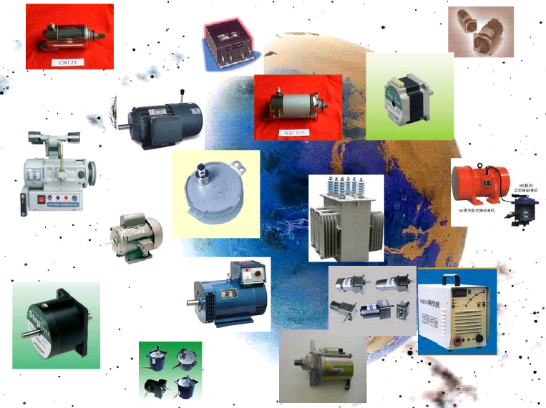
1.1 Electrical Machines, Transformers and Daily life
Northeastern University Feb 18, 2008

Slide 3
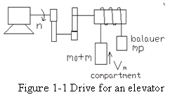
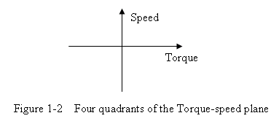
1.2 Some Examples of Application

Slide 4
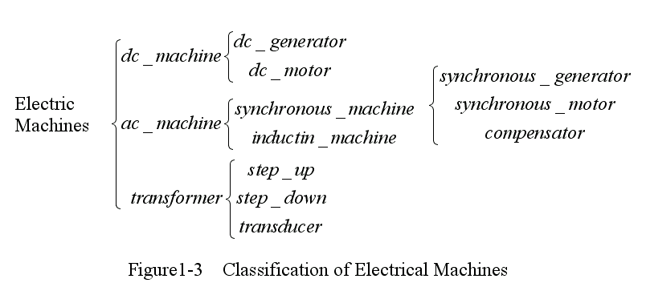
1.3 Classification of Electrical Machines

Slide 5
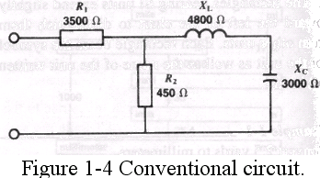
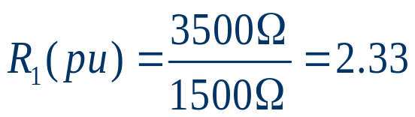
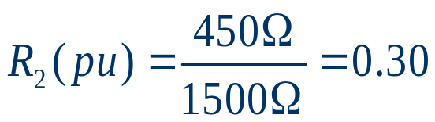
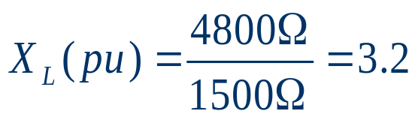
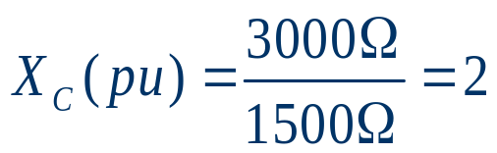
1.4 Per-unit System
1.4.1 Per-unit System With One Base
If we select the size of only one quantity as our measuring stick, the per-unit system is said to have a single base.
for example, the circuit in Figure. 1-4, composed of several resistors, capacitors, and inductors having the impedances shown. If we decide to use an impedance of 1500 ohms as the base, the per-unit impedances are as follows:

Slide 6
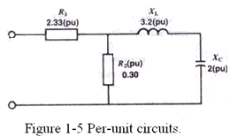
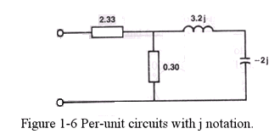
The per-unit circuit is shown in Figure 1-5
1.4.1 Per-unit System With One Base
if phasor notation is used, the per-unit circuit is shown in
Figure. 1-6.

Slide 7

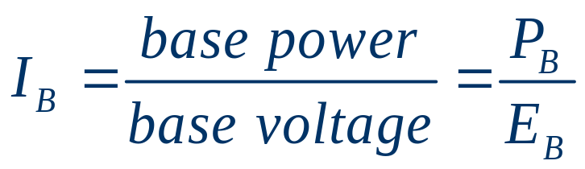
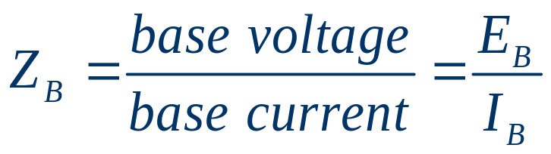
1.4 Per-unit System
1.4.2 Per-unit System With Two Bases
One interesting feature of the voltage/power per-unit system is that it automatically establishes a corresponding base current and base impedance. Thus the base current is
And the base impedance is
In effect, by selecting the voltage/power per-unit system we also get a base current and a base impedance. Consequently, the so-called 2-base per-unit system really gives us a 4-base per-unit system.

Slide 8

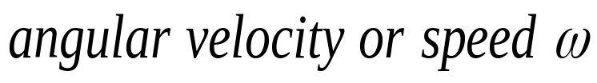
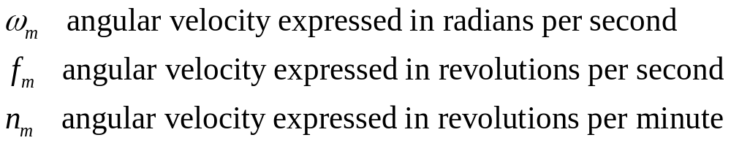
1.5 Rotational motion, Newton’s Law and power relationships
is usually measured in radians or degrees
the rate of change in angular position with respect to time.

Slide 9

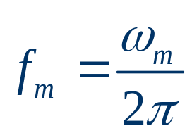
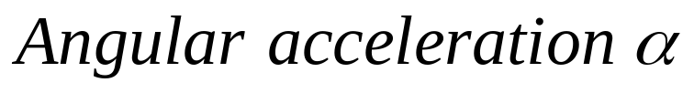
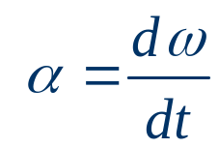

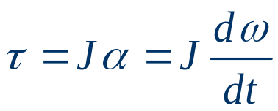
From the above definitions
1.5 Rotational motion, Newton’s Law and power relationships
is measured in radians per second squared
is measured in newton-meters
is measured in kilogram-meters squared

Slide 10




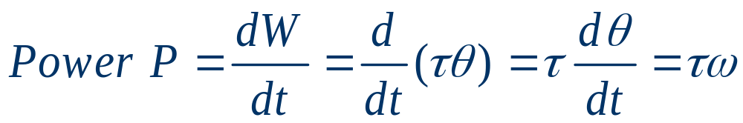
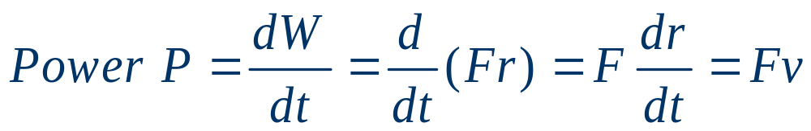
1.5 Rotational motion, Newton’s Law and power relationships

Slide 11








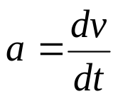
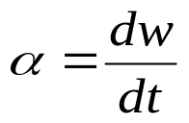








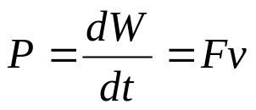
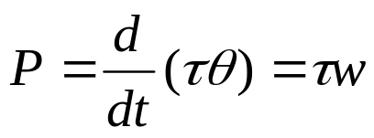
Relationships of Linear Motion and Revolution
Linear Motion |  | Revolution
 | distance |  | angular
W |  | W
P |  | P

Slide 12
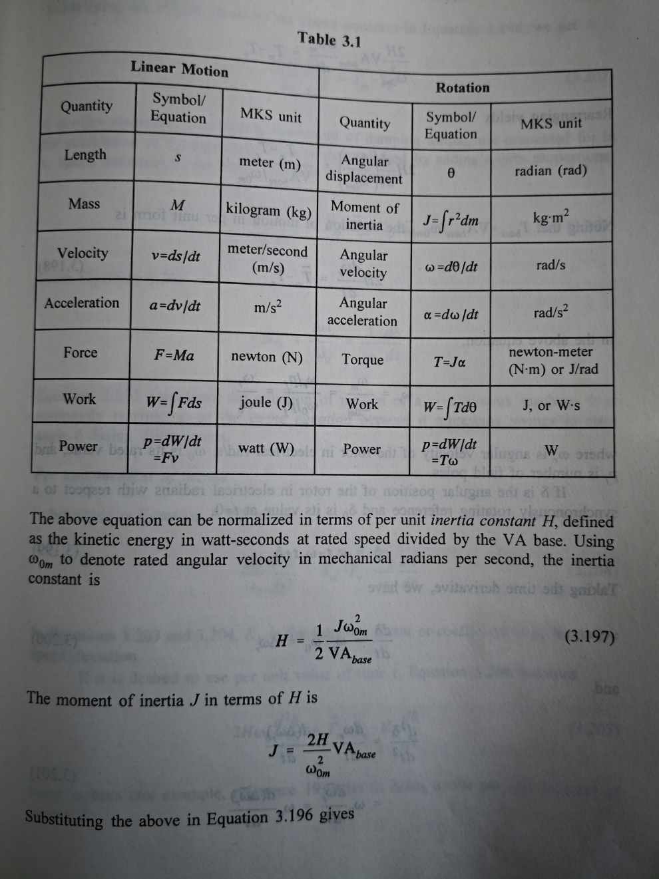
Relationships of Linear Motion and Revolution

Slide 13
1.6 Magnetic System Fundamentals
A current-carrying wire produces a magnetic field in the area around it.
A time-changing magnetic field induces a voltage in a coil of wire if it passes through that coil. (This is the basis of transformer action.)
A current-carrying wire in the presence of a magnetic field has a force induced on it. (This is the basis of motor action.)
A moving wire in the presence of a magnetic field has a voltage induced in it. (This is the basis of generator action.)
Notes:
This section describes and elaborates on the production of a magnetic field by a
current-carrying wire, while later sections of this chapter explain the remaining
three principles.

Slide 14

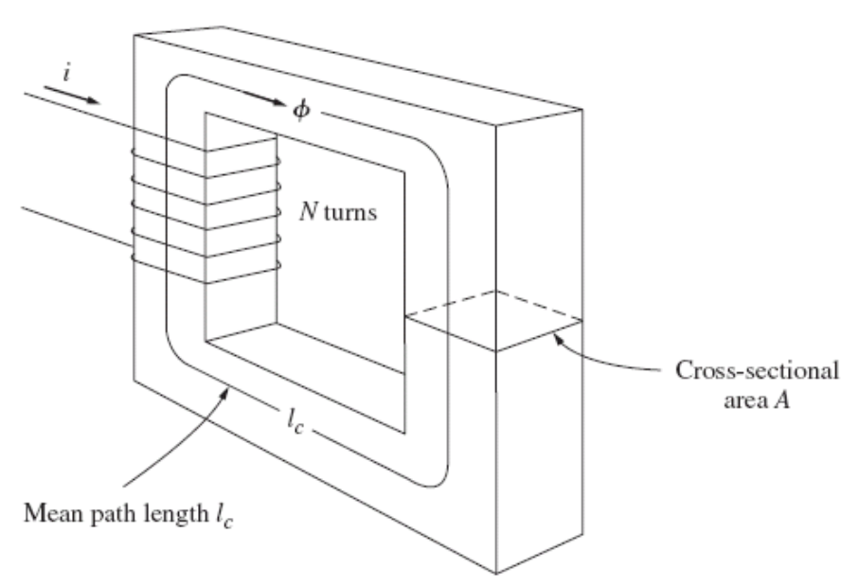

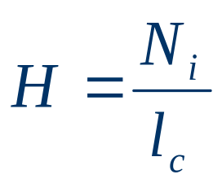
1.6 Magnetic System Fundamentals
1.6.1 Production of a Magnetic Field
Ampere’s Law 安培定律
where H is the magnetic field intensity in ampere-turns per meter.
Ampere’s law thus becomes

Slide 15
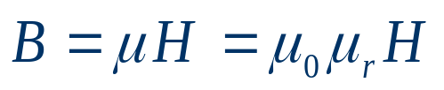
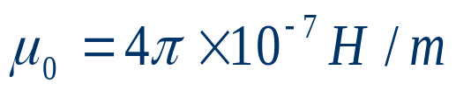



The relationship between H and B
1.6.1 Production of a Magnetic Field
where
H magnetic field intensity 磁场强度
B Flux density 磁通密度
permeability of material 磁导率
The permeability of free space 真空磁导率
Relative permeability 相对磁导率
Notes:
The relationship between the magnetic field intensity H and the resulting magnetic
flux density B produced within a material is given by
Relative permeability is a convenient way to compare the magnetizability of
materials. For example, the steels used in modern machines have relative permeabilities
of 2000 to 6000 or even more. This means that, for a given amount of
current, 2000 to 6000 times more flux is established in a piece of steel than in a
corresponding area of air. (The permeability of air is essentially the same as the
permeability of free space.) Obviously, the metals in a transformer or motor core
play an extremely important part in increasing and concentrating the magnetic
flux in the device.

Slide 16
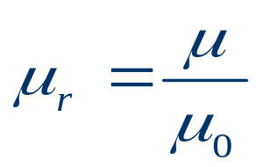
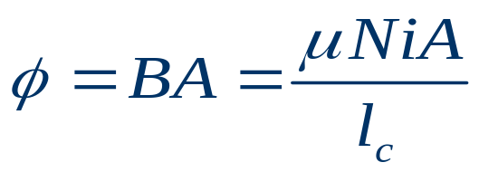


1.6.1 Production of a Magnetic Field
relative permeability:
flux
Ohm’s Law of magnetic circuit：
Magnetomotive force 磁（动）势

Slide 17
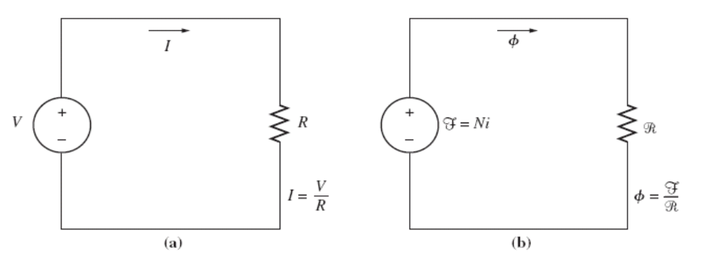

Magnetic Circuits
1.6.1 Production of a Magnetic Field
In a simple electric circuit

Slide 18





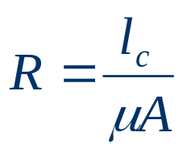

1.6.1 Production of a Magnetic Field
By analogy, the corresponding quantity in the magnetic circuit
Where:
magnetomotive force of circuit
flux of circuit
reluctance of circuit
Notes:
“fringing effect” 边缘效应

Slide 19
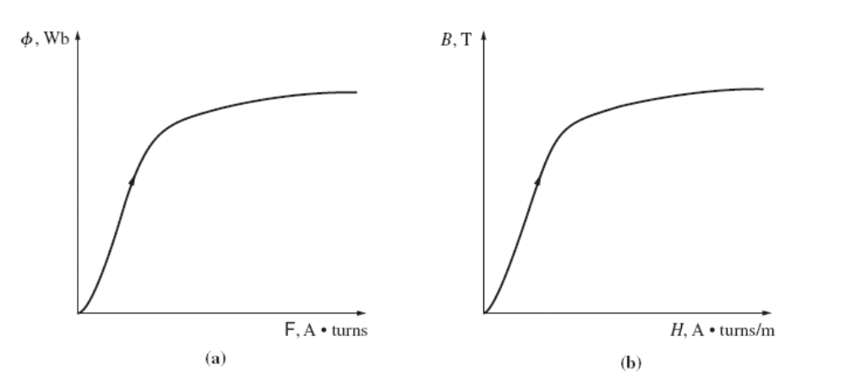
Magnetic Behavior of Ferromagnetic Materials
1.6.1 Production of a Magnetic Field

Slide 20
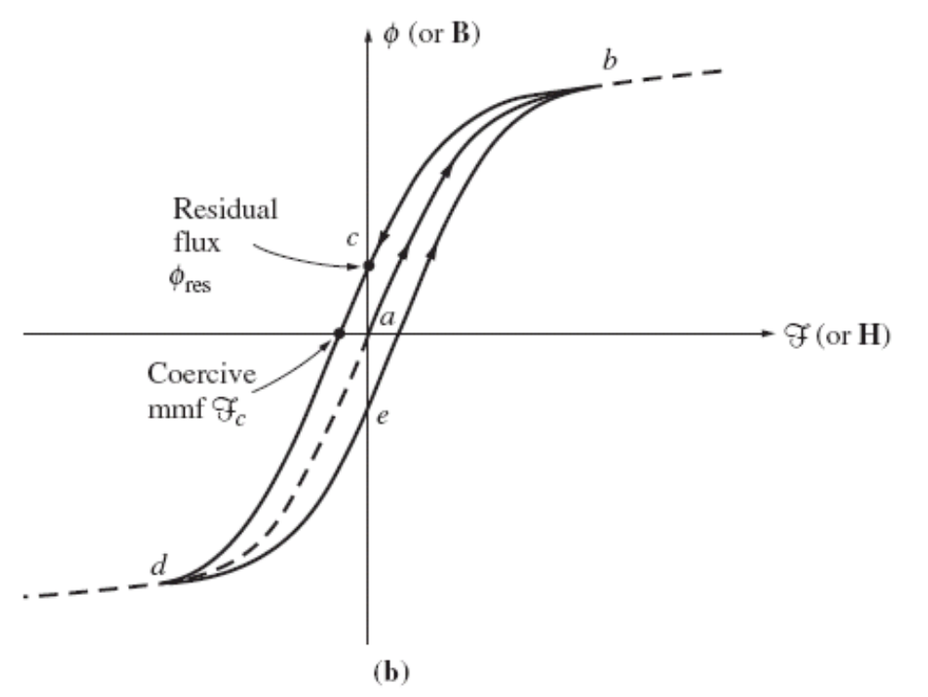
1.6.2 Iron Losses
1.6 Magnetic System Fundamentals
This is basically the saturation curve
Hysteresis loop
Notes:
the resulting failure to retrace flux paths is called hysteresis.
Notice that if a large magnetomotive force is first applied to the core and
then removed, the flux path in the core will be abc. When the magnetomotive
force is removed, the flux in the core does not go to zero. Instead, a magnetic field
is left in the core. This magnetic field is called the residual flux in the core. It is in
precisely this manner that permanent magnets are produced. To force the flux to
zero, an amount of magnetomotive force known as the coercive magnetomotive
force Fc must be applied to the core in the opposite direction.

Slide 21
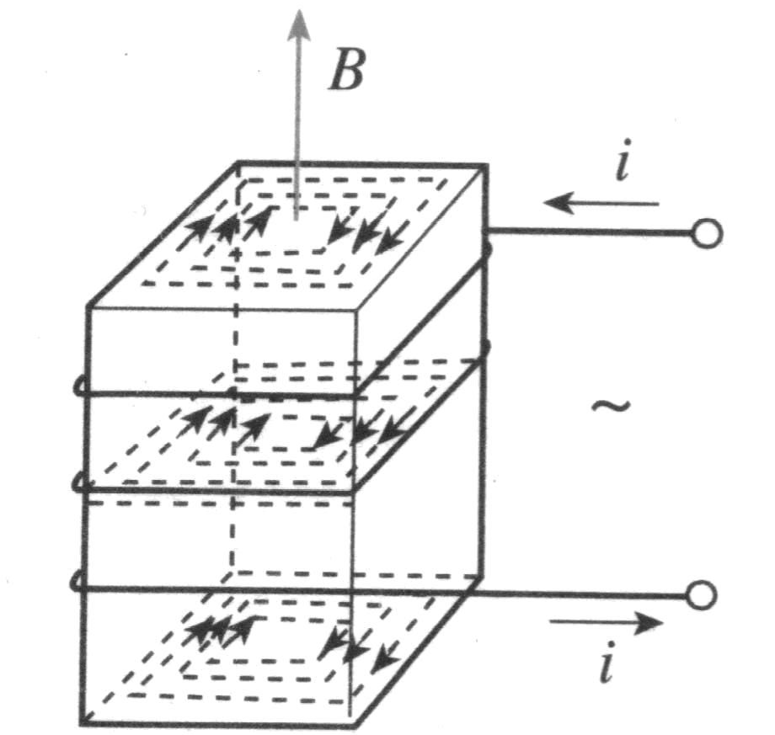
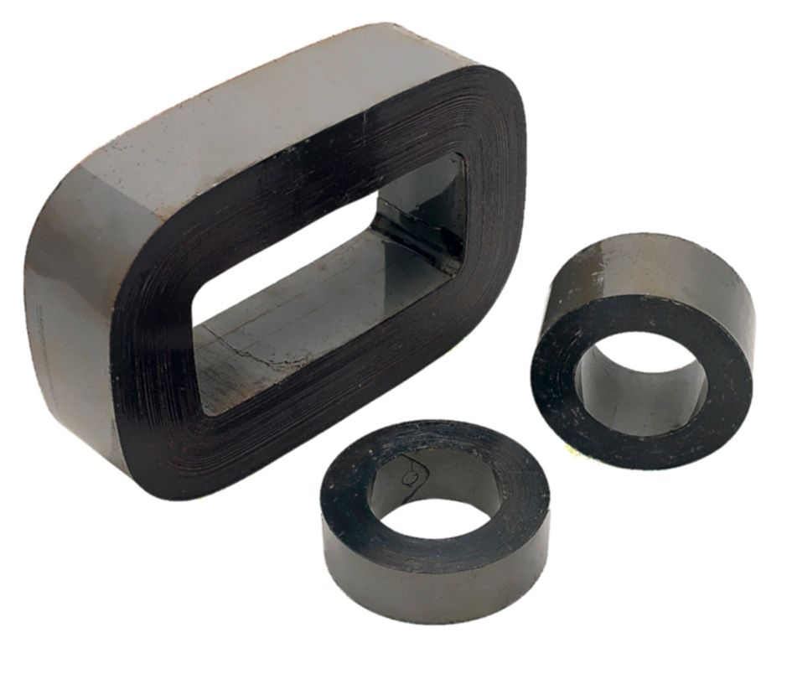
1.6.2 Iron Losses
1.6 Magnetic System Fundamentals
Eddy current
Notes:
the resulting failure to retrace flux paths is called hysteresis.
Notice that if a large magnetomotive force is first applied to the core and
then removed, the flux path in the core will be abc. When the magnetomotive
force is removed, the flux in the core does not go to zero. Instead, a magnetic field
is left in the core. This magnetic field is called the residual flux in the core. It is in
precisely this manner that permanent magnets are produced. To force the flux to
zero, an amount of magnetomotive force known as the coercive magnetomotive
force Fc must be applied to the core in the opposite direction.

Slide 22
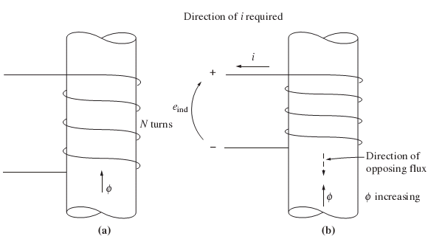
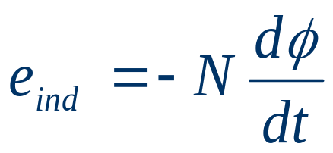
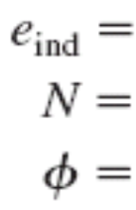
1.6.3 Faraday’s Law—Induced Voltage From A Time-Changing Magnetic Field
Faraday’s law states that if a flux passes through a turn of a coil of wire, a voltage will be induced in the turn of wire that is directly proportional to the rate of change in the flux with respect to time. In equation form
where
voltage induced in the coil
number of turns of wire in coil
flux passing through coil
The minus sign in the equations is an expression of Lenz’s law.
Notes:
So far, attention has been focused on the production of a magnetic field and on its
properties. It is now time to examine the various ways in which an existing magnetic
field can affect its surroundings.

Slide 23
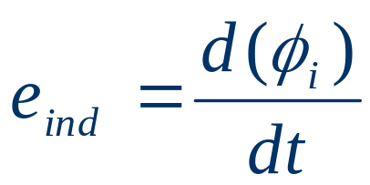
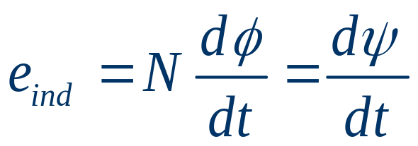

1.6.3 Faraday’s Law—Induced Voltage From A Time-Changing Magnetic Field
The magnitude of the voltage in the turn of the i th coil is always given by
If there are N turns in the coil of wire, the total voltage on the
coil is
Where is called the flux linkage in weber-turns.
Faraday’s law is the basis of transformer action.

Slide 24
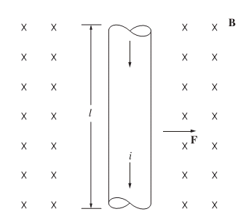
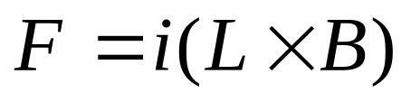
1.6 Magnetic System Fundamentals
1.6.4 Production Of Induced Force On a Wire
The force induced on the conductor is given by
where
i =magnitude of current in wire
l = length of wire, with direction
of l defined to be in the direction
of current flow
B = magnetic flux density vector
Notes:
A second major effect of a magnetic field on its surroundings is that it induces a
force on a current-carrying wire within the field.
where
i magnitude of current in wire
l length of wire, with direction of l defined to be in the direction of
current flow
B magnetic flux density vector

Slide 25


1.6.4 Production Of Induced Force On a Wire
The direction of the force is given by the left-hand rule: If the index finger of the right hand points in the direction of the vector l and the middle finger points in the direction of the flux density vector B, then the thumb points in the direction of the resultant force on the wire
The magnitude of the force is given by the equation
where is the angle between the wire and the flux density
vector.
The induction of a force in a wire by a current in the presence of a magnetic field is the basis of motor action.

Slide 26
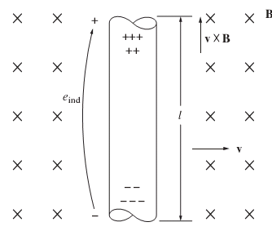
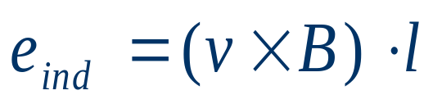
1.6.5 Induced Voltage On a Conductor Moving
In a Magnetic Field
1.6 Magnetic System Fundamentals
If a wire with the proper orientation moves through a magnetic field, a voltage is induced in it. The voltage induced in the wire is given by
where
v = velocity of the wire
B = magnetic flux density vector
l = length of conductor in the
magnetic field
The direction of the induced voltage is given by the right-hand rule

Slide 27
1.6.5 Induced Voltage On a Conductor Moving
In a Magnetic Field
summary
1. Mechanics, the concepts of angular position, angular velocity, angular acceleration, torque, Newton’s law, work, and power were explained for the special case of rotation about a single axis.
2. The production of a magnetic field by a current.
The special properties of ferromagnetic materials
The shape of the magnetization curve
Concept of hysteresis, and eddy current losses

Slide 28
1.6.5 Induced Voltage On a Conductor Moving
In a Magnetic Field
summary
3. Faraday’s law: a voltage will be generated in a coil of wire Faraday’s law is the basis of transformer action,
4. A current-carrying wire will have a force induced on it. This behavior is the basis of motor action in all real machines.
5. A wire moving: have a voltage induced in it.
This behavior: the basis of generator action

